Slide 1
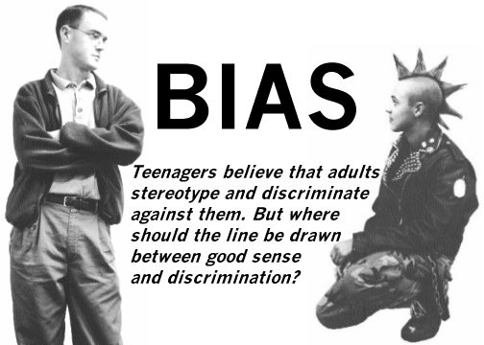
What is Bias?
When a writer can’t hide these feelings, or lets them affect the writing.

Slide 2
How Do I Identify Bias?
Step 1:
Determine who the author or speaker is:
Find out as much as you can about them
You can’t determine bias until you know a little something about what the authors’ feelings or experiences are.
Some Key Questions to ask:
Who does the author work for?
How old are they?
Does your speaker have special skills or expertise in any area?

Slide 3
How Do I Identify Bias? Cont’d…
Step 2:
Determine what central point the author or speaker is trying to make:
Find the main idea.
Some Key Questions to ask:
What is the main idea or central concept the author is trying to communicate?
Be on the lookout for any specific actions that the writer or speaker wants you take?

Slide 4
How Do I Identify Bias? Cont’d…
Step 3:
Be on the lookout for loaded words, stereotypes, or one-sided arguments.
Loaded Words
Words that have strong emotions behind them.
Ex. Today’s children are unruly and horrendous in class.
Stereotypes
Label all members of a group as being the same and does not take in to count individual differences. This often results in prejudice.
Ex. All Mexicans are illegal.
One Sided Arguments
Writers only present one-side of the situation.

