Slide 1
CHARACTERIZATION
EQ: How does understanding characterization help us to understand the story?

Slide 2
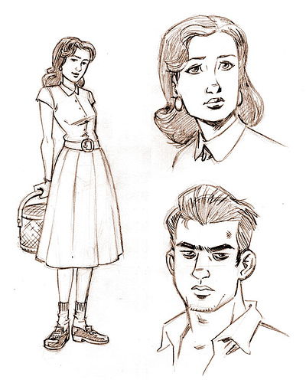
What is characterization?
Characterization is the process by which the writer reveals the personality of the character.

Slide 3
What is a character trait?
All those used to describe a character such as patient, kind, bossy.

Slide 4
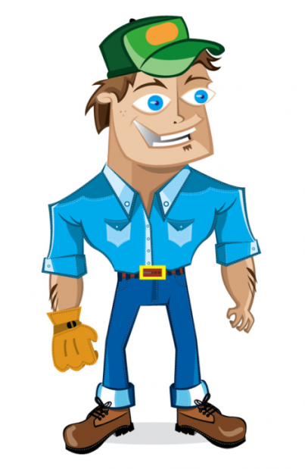
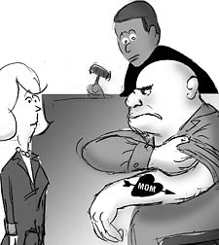
Character traits can be:
Physical
Tall
Personality
Funny
Shy
Focus on Personality Traits

Slide 5
Personality character traits describing a person can be:
Permanent
Temporary
Changing
Character changes from the beginning to the end

Slide 6
With so many traits, what’s really important?
Focus on traits that offer many examples in the story and that are not there for just a short while.
They must matter to the story.

Slide 7
How do you identify character traits in a story?
1. Indirect Characterization (implicit or inferred) (You have to guess!) (shown by actions, words, etc)

Slide 8
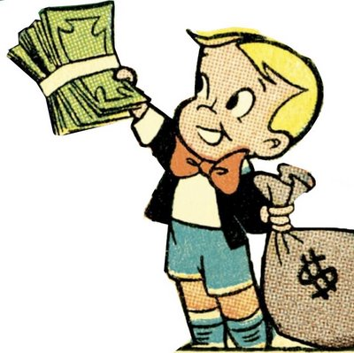
How do you identify character traits in a story?
Example for “Generous”
Richard was a generous person.
Richard gave away lots of money to anyone who needed it.
Stated - explicit
Infer - implicit
Well-developed characters help to make very powerful stories.

Slide 9
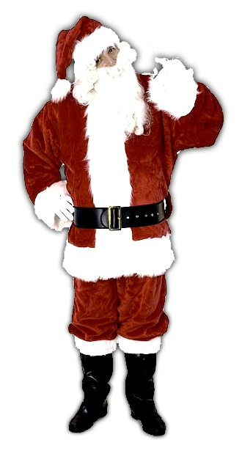
ways to identify character traits in a story:
Indirect
Characterization
What the character looks like (physical appearance)

Slide 10
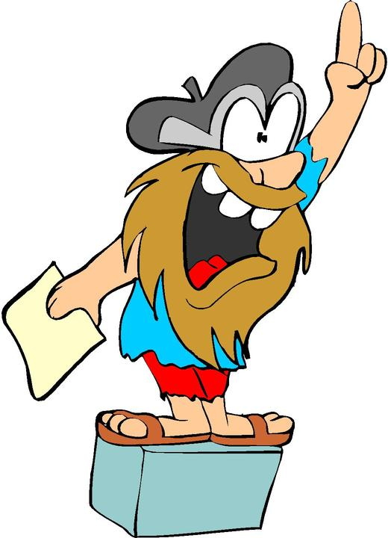
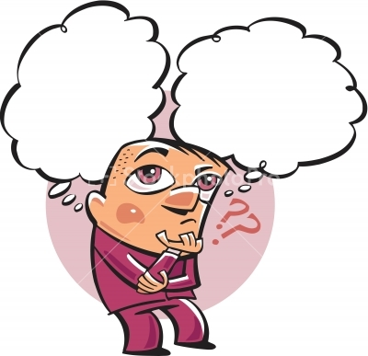
ways to identify character traits in a story:
What the character says and thinks

Slide 11
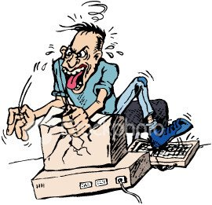
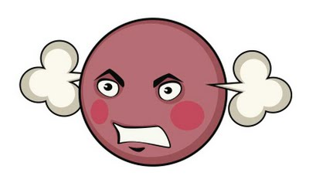
ways to identify character traits in a story:
What the character does or does not do

Slide 12
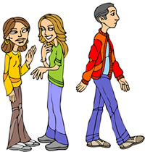
ways to identify character traits in a story:
What others say & think about the character and.,,

Slide 13
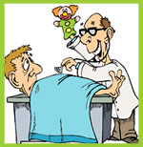
ways to identify character traits in a story:
How others react to the character

Slide 14
Direct Characterization
Direct Characterization- Explicit or stated (Just tell us!!)

Slide 15
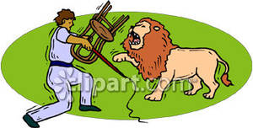
ways to identify character traits in a story:
Character’s Motivation – WHY does the character do what he does?

Slide 16
How to explain/prove a character’s traits:
When asked to explain a character’s traits:
State trait
Use specific examples of a trait
Make connection between the example and the trait.

Slide 17
How to explain/prove A character traits:
You say Brian is brave because ….
Poor example: … he travels down the river and overcomes many obstacles.
Good example: … while traveling down the river, he jumps in the water to save his sister even though he is afraid of the water. When you are afraid and you still do it, it shows bravery.

Slide 18
How to explain/prove A character traits:
State the trait
You say Brian is brave because ….
Good example: … while traveling down the river, he jumps in the water to save his sister even though he is afraid of the water. When you are afraid and you still do it, it shows bravery.

Slide 19
How to explain/prove A character traits:
You say Brian is brave because ….
Good example: … while traveling down the river, he jumps in the water to save his sister even though he is afraid of the water. When you are afraid and you still do it, it shows bravery.
Give example

Slide 20
How to explain/prove A character traits:
You say Brian is brave because ….
Good example: … while traveling down the river, he jumps in the water to save his sister even though he is afraid of the water. When you are afraid and you still do it, it shows bravery.
Make a connection

Slide 21
Characters
Protagonist – the main character– the focus of the reader’s attention
Antagonist – a person or force in conflict with the protagonist

Slide 22
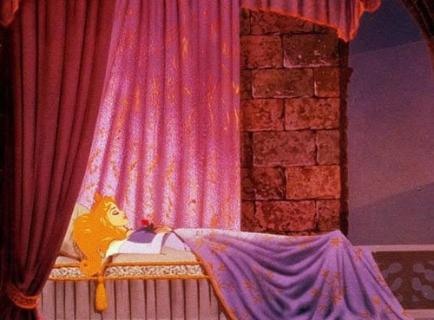
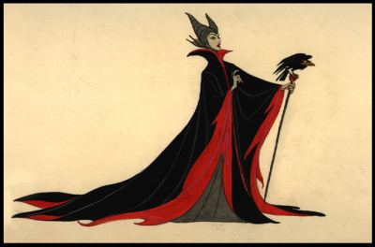
Characters
Protagonist Antagonist

Slide 23
Characters
Protagonist Antagonist

Slide 24
“Dominant” & “Prominent”
Often, a writing prompt will ask you to identify a person’s “dominant” or “prominent” trait.
The person’s #1 or “biggest” trait.
One word, more that any other word, that best describes the character

Slide 25
Website powerpoint is from: http://www.carlisleschools.org/webpages/doulgerisk/teaching.cfm?subpage=839199
http://www.urfunworld.com/image/cartoon_image/sleepingbeauty.jpg
http://www.mpimages.net/mp/compressed/promotional/SleepingBeauty-DVDBonus10373.jpg
http://baptistbalance.com/images/laugh.jpg
http://www.pamf.org/images/preteen/gossipgroup.jpg
http://www.mrwhitechristmas.com/images/products/sw3917_santa.jpg
http://img259.imageshack.us/i/angrycomputerusersb5.jpg/#q=getting%20angry%20easily
http://www.sojo.net/images/blog/070307_drowning.gif
http://www.picturesof.net/_images_300/Lion_Tamer_In_the_Circus_Royalty_Free_Clipart_Picture_090121-024328-287042.jpg
http://2.bp.blogspot.com/_OOekoxiajIU/SocUanbO6NI/AAAAAAAAAwQ/rx1-Oug3KVE/s400/angry-face.jpg
http://www.stockphotopro.com/photo-thumbs-2/stockphotopro_05708VXF_no_title.jpg
http://www.knowledgeshopatlanta.com/images/Public%20Speaking.jpg
http://www.moytoy.eu/var/moytoy/storage/images/community/members/berger-hill-studios/character-designs-from-berger-hill-studios/13259-1-eng-US/Character-Designs-from-Berger-Hill-Studios_big.png
http://westapps.west.thomson.com/WestHeadnote/images/03-06-09.jpg
http://farm1.static.flickr.com/53/206768209_ce2cda4cdd.jpg

