Slide 1
The Setting
Essential Questions for this lesson:
What are the two parts to a setting?
How does an author use setting to help us understand a story?

Slide 2
The setting
The setting is the time and location in which a story takes place. When and Where?
For some stories, the setting is very important while others it is not so important.
http://www.school-clipart.com/_small/0511-0806-1016-3456.jpg

Slide 3
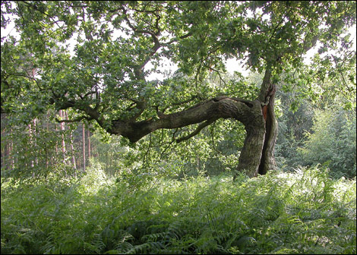
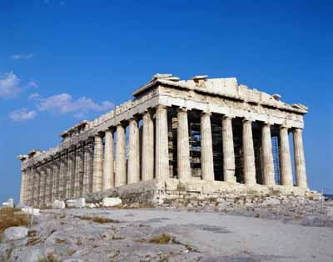
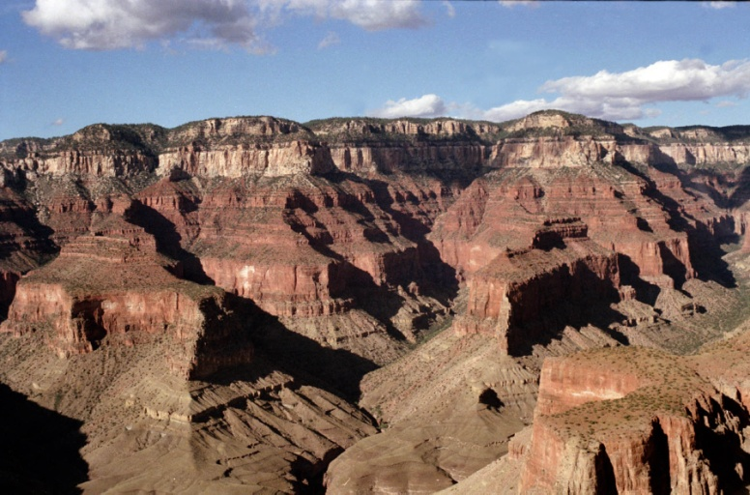
Aspects of a story’s setting
1. Place – geographical location. Where does the action of the story take place?

Slide 4
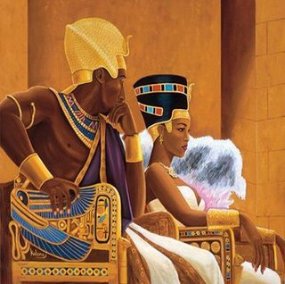
Aspects of a story’s setting
2. Time – When is the story taking place? (historical period, time of day, year etc.

Slide 5
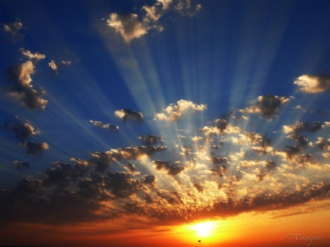
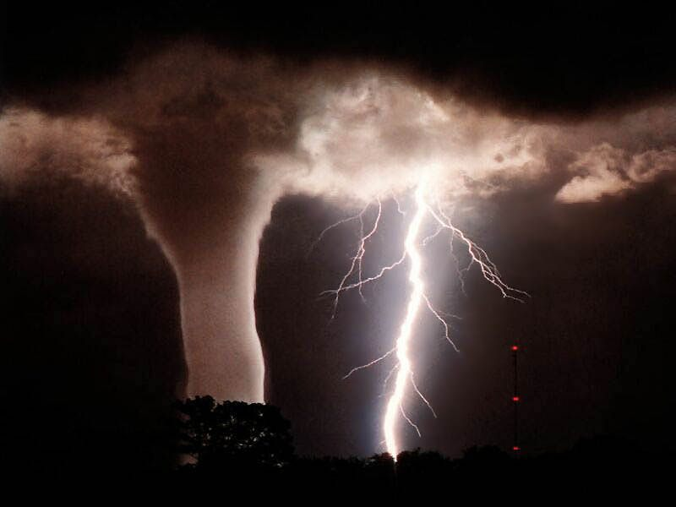
Aspects of a story’s setting
3. Weather conditions – Is it rainy, sunny, stormy, etc?

Slide 6
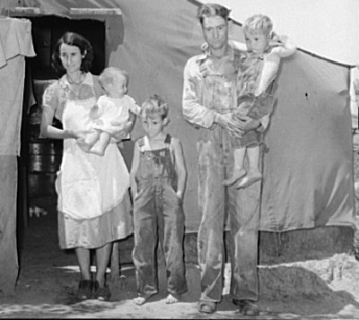
Aspects of a story’s setting
4. Social conditions – What is the daily life of the character like? Does the story contain local color (writing that focuses on the speech, dress, mannerisms, customs etc. of a particular place?

Slide 7
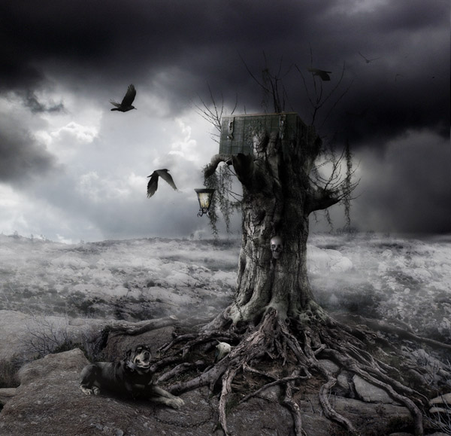
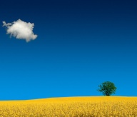
Aspects of a story’s setting
5. Mood or atmosphere – What feeling is created at the beginning of the story? Bright and cheerful? Dark and frightening?

Slide 8
Aspects of a story’s setting
1. Place – geographical location. Where does the action of the story take place?
2. Time – When is the story taking place? (historical period, time of day, year etc.
3. Weather conditions – Is it rainy, sunny, stormy, etc?
4. Social conditions – What is the daily life of the character like? Does the story contain local color (writing that focuses on the speech, dress, mannerisms, customs etc. of a particular place?
5. Mood or atmosphere – What feeling is created at the beginning of the story? Bright and cheerful? Dark and frightening?

Slide 9
This Powerpoint is from : http://www.carlisleschools.org/webpages/doulgerisk/teaching.cfm?subpage=839199
http://www.eurograduate.com/images/articles/news/parthenon-and-the-acropolis-landmark-1.jpg
http://www.depauw.edu/photos/PhotoDB_Repository/2007/3/House%20Clip%20Art.gif
http://www.bbc.co.uk/nottingham/content/images/2005/09/17/sheila_norton_title_ancient_oak_of_sherwood_forest_470x336.jpg
http://img.villagephotos.com/p/2005-3/971607/3dclocks.jpg
http://earthscience.files.wordpress.com/2007/05/tornado.jpg
http://www.primetravels.com/PackageImages/691/grand-canyon.jpg
http://www.ancienthistoricalsociety.org/images/AfricanKingandQueen.jpg
http://www.wisebread.com/files/fruganomics/imagecache/blog_image_full/files/fruganomics/blog-images/depression-family-3.jpg
http://thumb1.visualizeus.com/thumbs/09/07/03/bright,landscape,nature,neat-7b77d983f121fc6a04a175cf861cd98a_m.jpg
pabs.us

