Slide 1
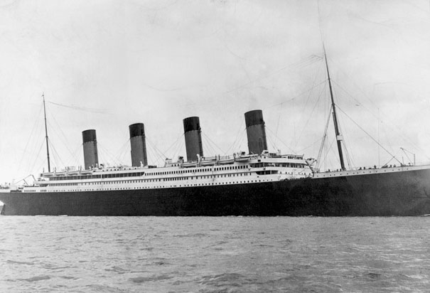
The Titanic in Six Rooms
How to plan your Poem

Slide 2
Create your Six Room Template…
Get a large sheet of white paper
Fold it into 6 equal parts
Each part will be a room
The following slides will explain the detailed notes you should jot down for each room
Next slide….

Slide 3
In the first room …
Specific Details – Analyze your photographs for all the specific details. Imagine that you can walk through your photograph as if you were really there. Jot down everything you can that would describe everything in the picture, including why YOU might be there. Include details about the big things that are visible, the little things, the partially hidden things, the things most people might not notice at first glance. Look at the photo and close your eyes re-creating the photo in your mind to think of more details. Don’t think of creating a poem yet. Just try to describe everything….

Slide 4
In the second room …
Put yourself into the photograph again. Focus on the quality of light in your photograph.
Is it bright?
Is it dull?
Is it hazy?
Are there any shadows?
Describe any colors (you will have to imagine the colors in the black and white photo, but you know there were colors.)
If it’s unclear what the light is like you might have to use some poetic license and make it up
You can also describe colors
Or if your image is, for example,
the stars, describe their light –
shiny, sparkling, red, blue

Slide 5
In the third room … What do you hear?
Focus on the sounds in your photograph…..
If your photo has no people in it, you can leave it that way – perhaps there are sounds of the air, sounds of the sea, background sounds, rustlings, etc.
If there is silence in your photo, what kind of silence is there?
Empty?
Lonely?
Peaceful?
Tense?
OR.. you can imagine the photo with people in it from the time period. What array of sounds would there be?

Slide 6
In room number four … What questions do you have?
Write down questions you have about the photograph or questions you may ask if you were in the photograph…
What things would you want to know more about?
What things do you wonder about?
What tweaks your curiosity?
Who? What? When? Where? How?

Slide 7
In the fifth room…
Write down the emotional feelings in your photograph.
What are the moods created?
What are the tones that the photograph is sending?
Hint………
If your photograph has no people, think of your photograph with people in it. What emotional feelings might they be portraying? The emotional feelings can include fears, ambitions, anxieties, positive emotions, negative emotions, neutral emotions!

Slide 8
Finally, in room number six …
Look over the 5 rooms you have already created.
Pull out a word that seems important and repeat it three times.
Create a phrase from the 5 rooms that seems important and repeat it three times
OR…..
create a longer line or sentence to repeat three times.

Slide 9
Now create a poem …
Read over everything you wrote in the six rooms…..
Your job now is to put it together into a free verse poem of your own.
Adding elements of poetry like…
similes, metaphors, personification… anything that helps to capture the rooms and the details you have.
You can re-arrange the rooms if you like
You can eliminate a room if you like
Add words, phrases, lines or take some out
After creating your poem, analyze it. Read it to yourself. REVISE YOUR POEM. Write your final copy on a new power-point presentation in stanzas. Include a title slide with your author name. Insert the image in places you feel are best.

Slide 10
Going beyond the Power-Point …
After creating your final power-point, do something really original! This is optional but can be very effective!
Save your power-point slides as jpeg images and import them into Photo-story.
You may have to modify your slides so font is bigger for the Photo-story.
Narrate your slides in photo-story.
If you do not choose to use Photo-Story, you may think about narrating your power-point slides to add “voice” to your poem.

