Slide 1
The Titanic
“In the Moment”
Photos for six room poem
Language Arts
Put on Slide Show Mode to view
Images courtesy of the Titanic Photo Gallery
History.com

Slide 2
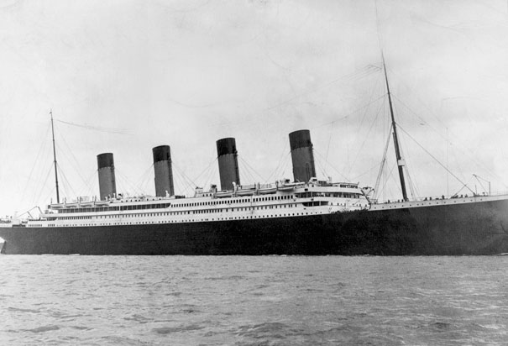
The Titanic 1912

Slide 3
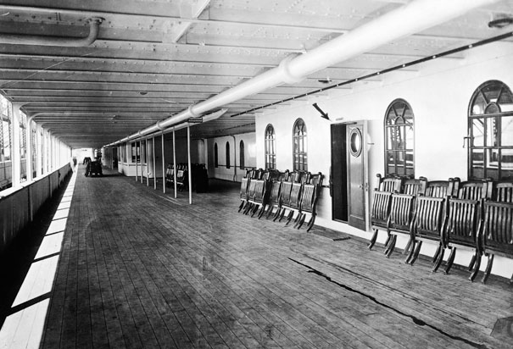
Promenade Deck on the Titanic

Slide 4
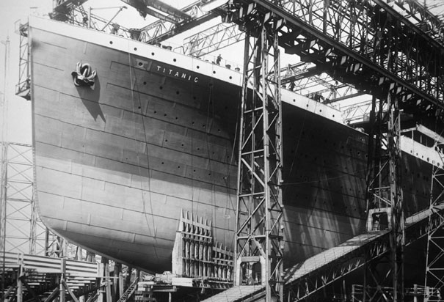
The Titanic Bow Construction

Slide 5
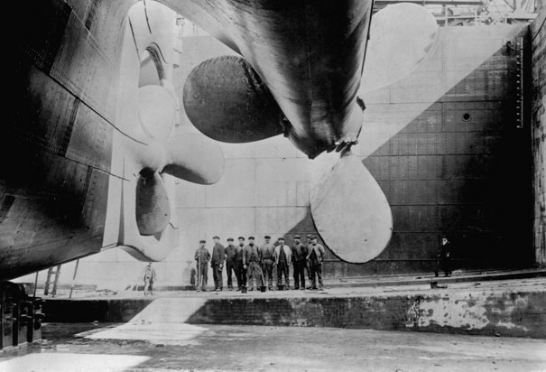
The Titanic Propellors

Slide 6
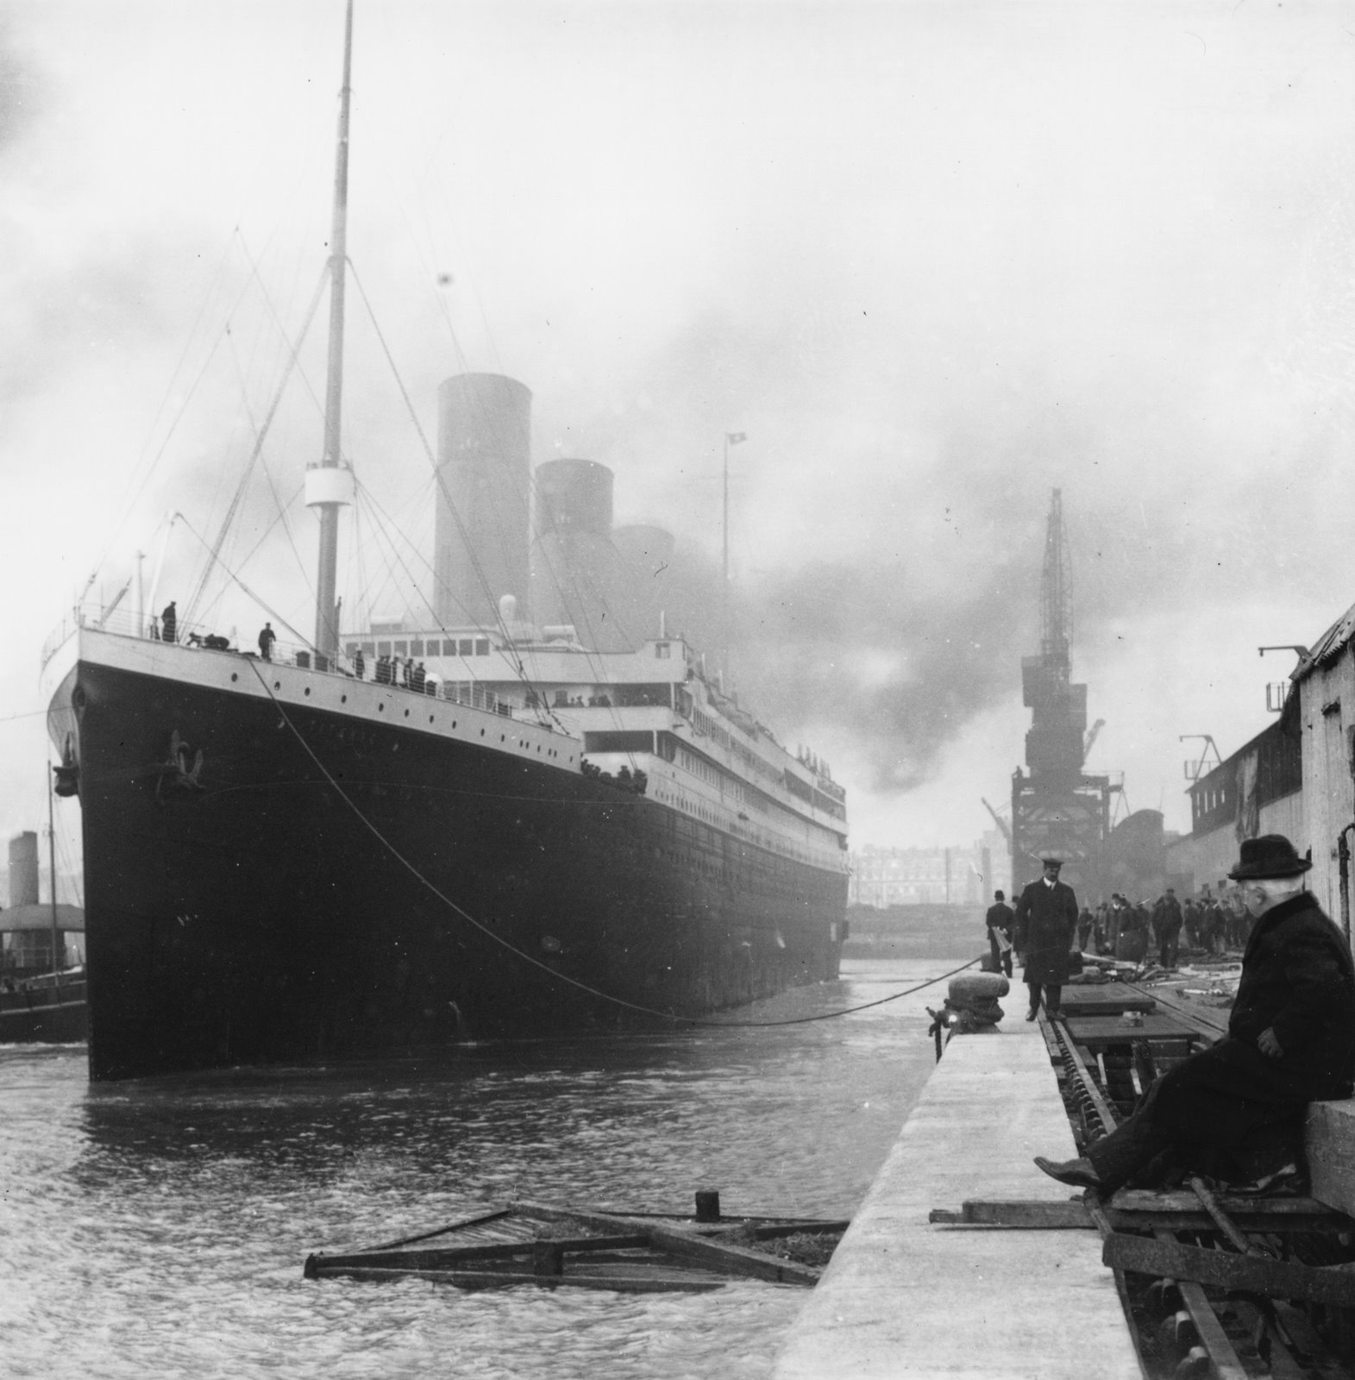
The Titanic at Southhampton

Slide 7
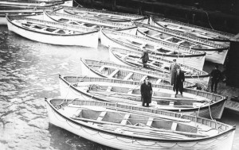

Slide 8
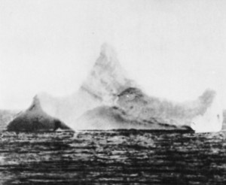
Ice-burg that The Titanic hit

Slide 9
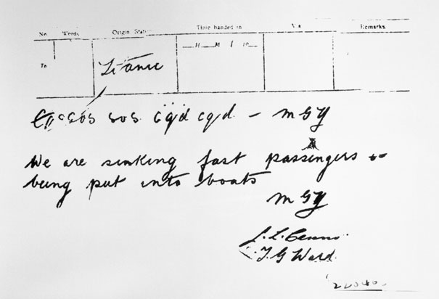
Message of Distress

Slide 10
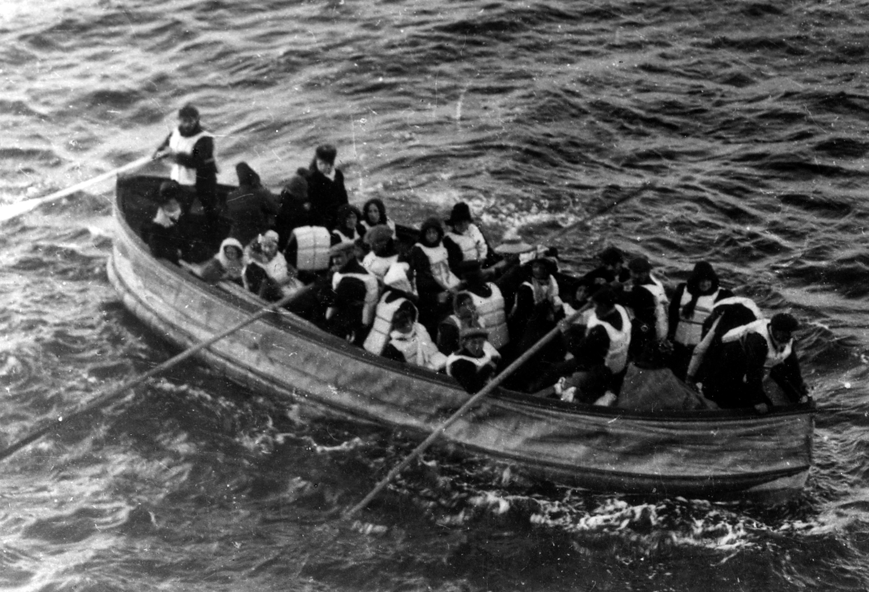
People in lifeboat

Slide 11
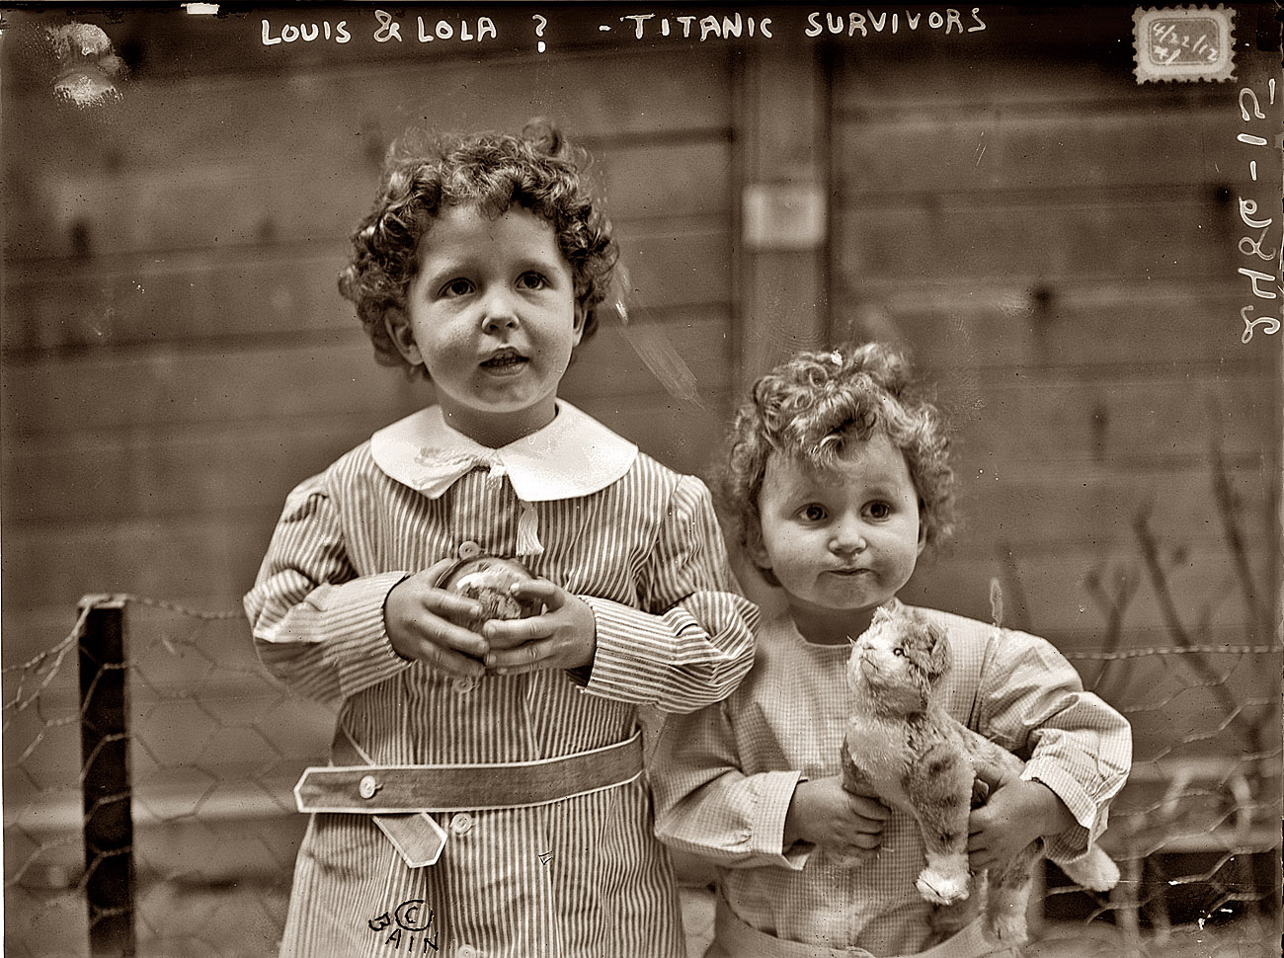
Titanic Orphans

Slide 12
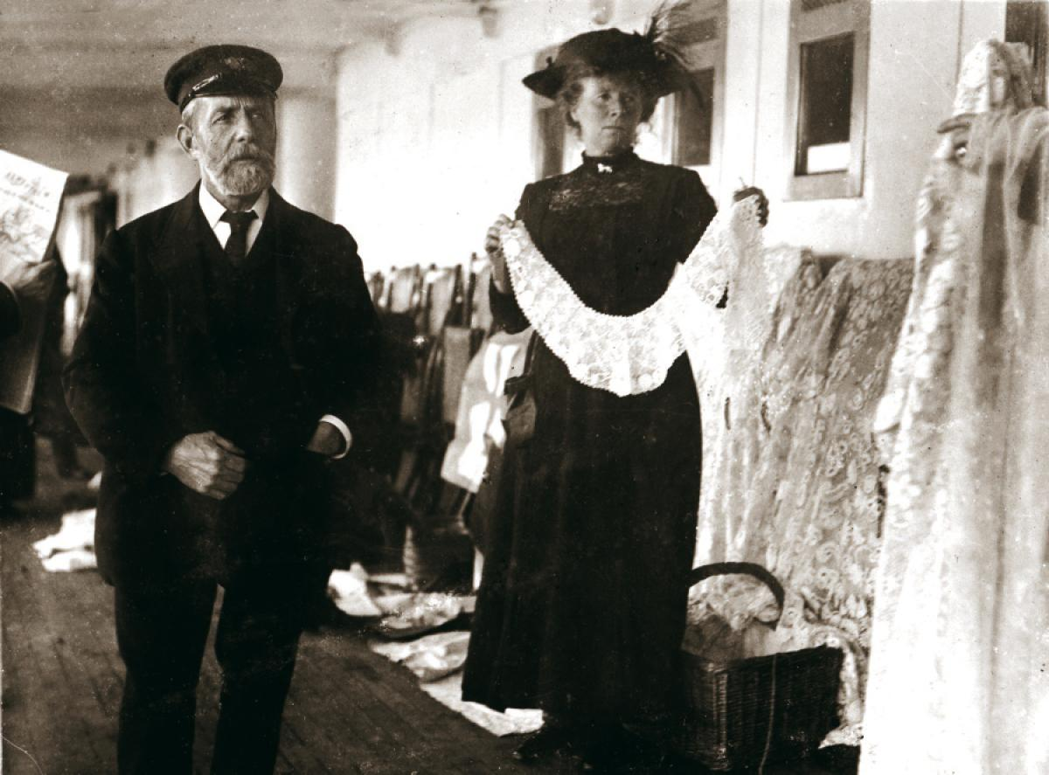
Captain John Edwards

Slide 13
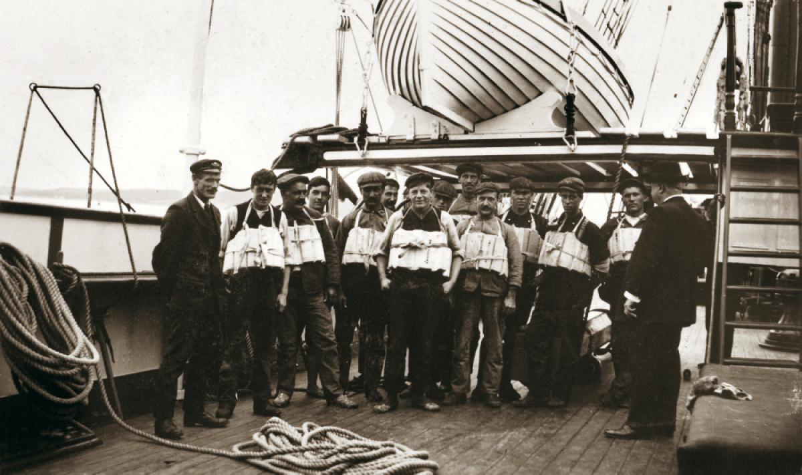
Life jacket inspection

Slide 14
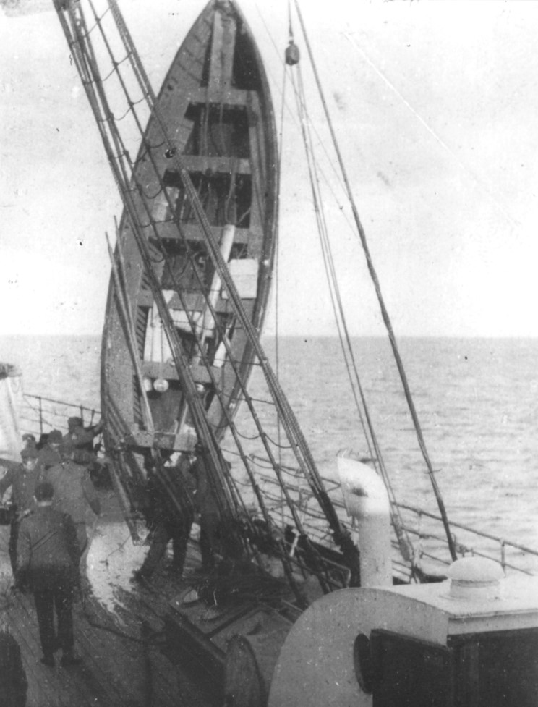
Life boat 12
On
Carpathia

Slide 15
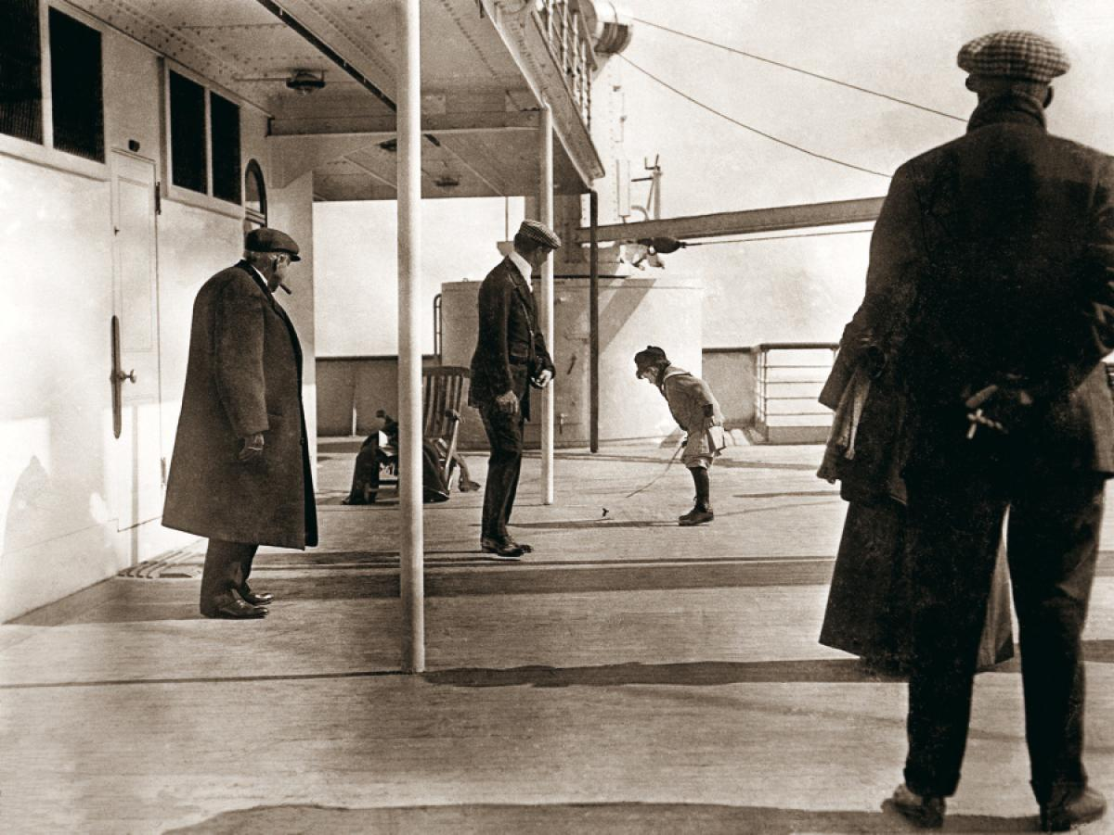
On Deck

Slide 16
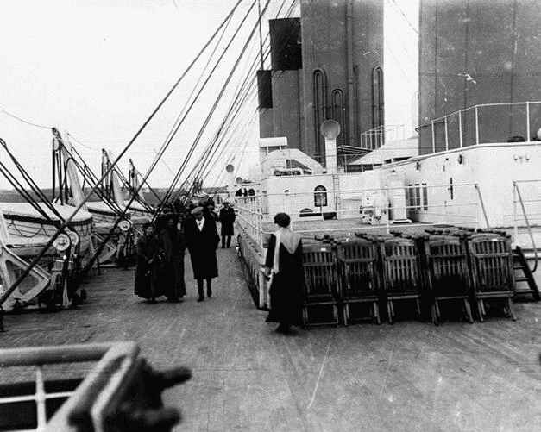
Walking on Deck

Slide 17
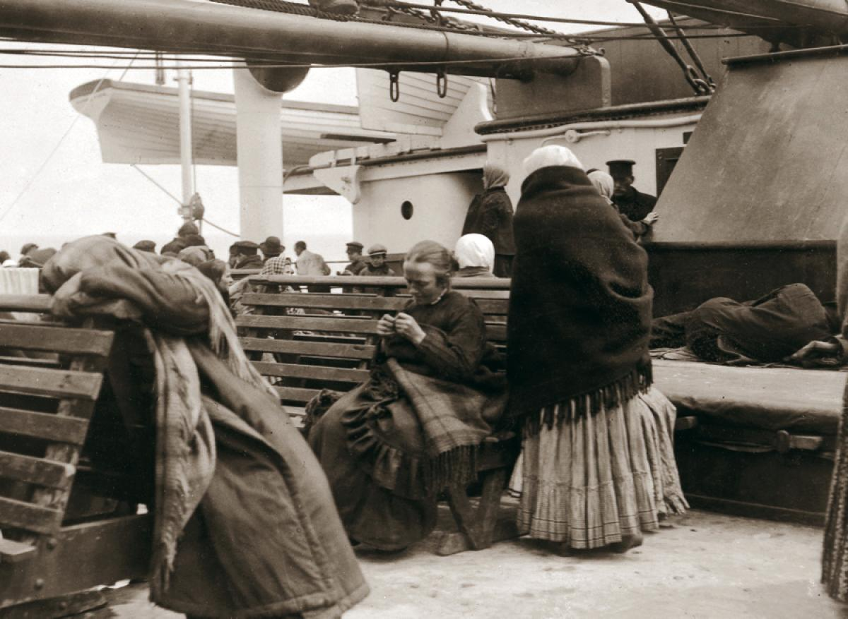
Steerage settling in

Slide 18
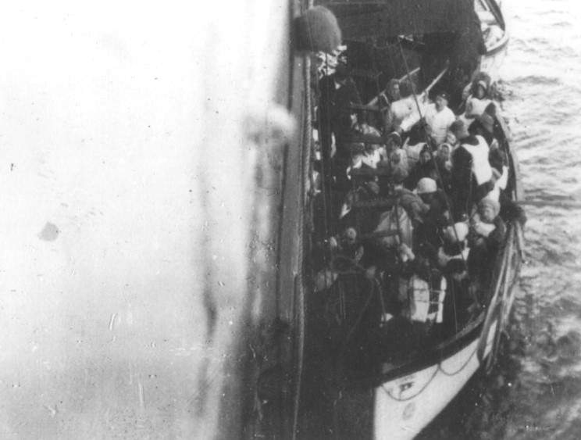
Life boat at Carpathia

Slide 19
Now, pick the photo
that makes a
significant impact
on you.
Follow directions for your six room poem…..

